Slide 1





Analysis of Lunar Sample Thermoluminescence:
A python-based glow curve deconvolution approach
by
Arjun Prem¹ and Alex Sehlke²
¹ Summit Tahoma High School, San Jose, CA
² NASA Ames Research Center/BAER Institute, Moffett Field, CA

Slide 2
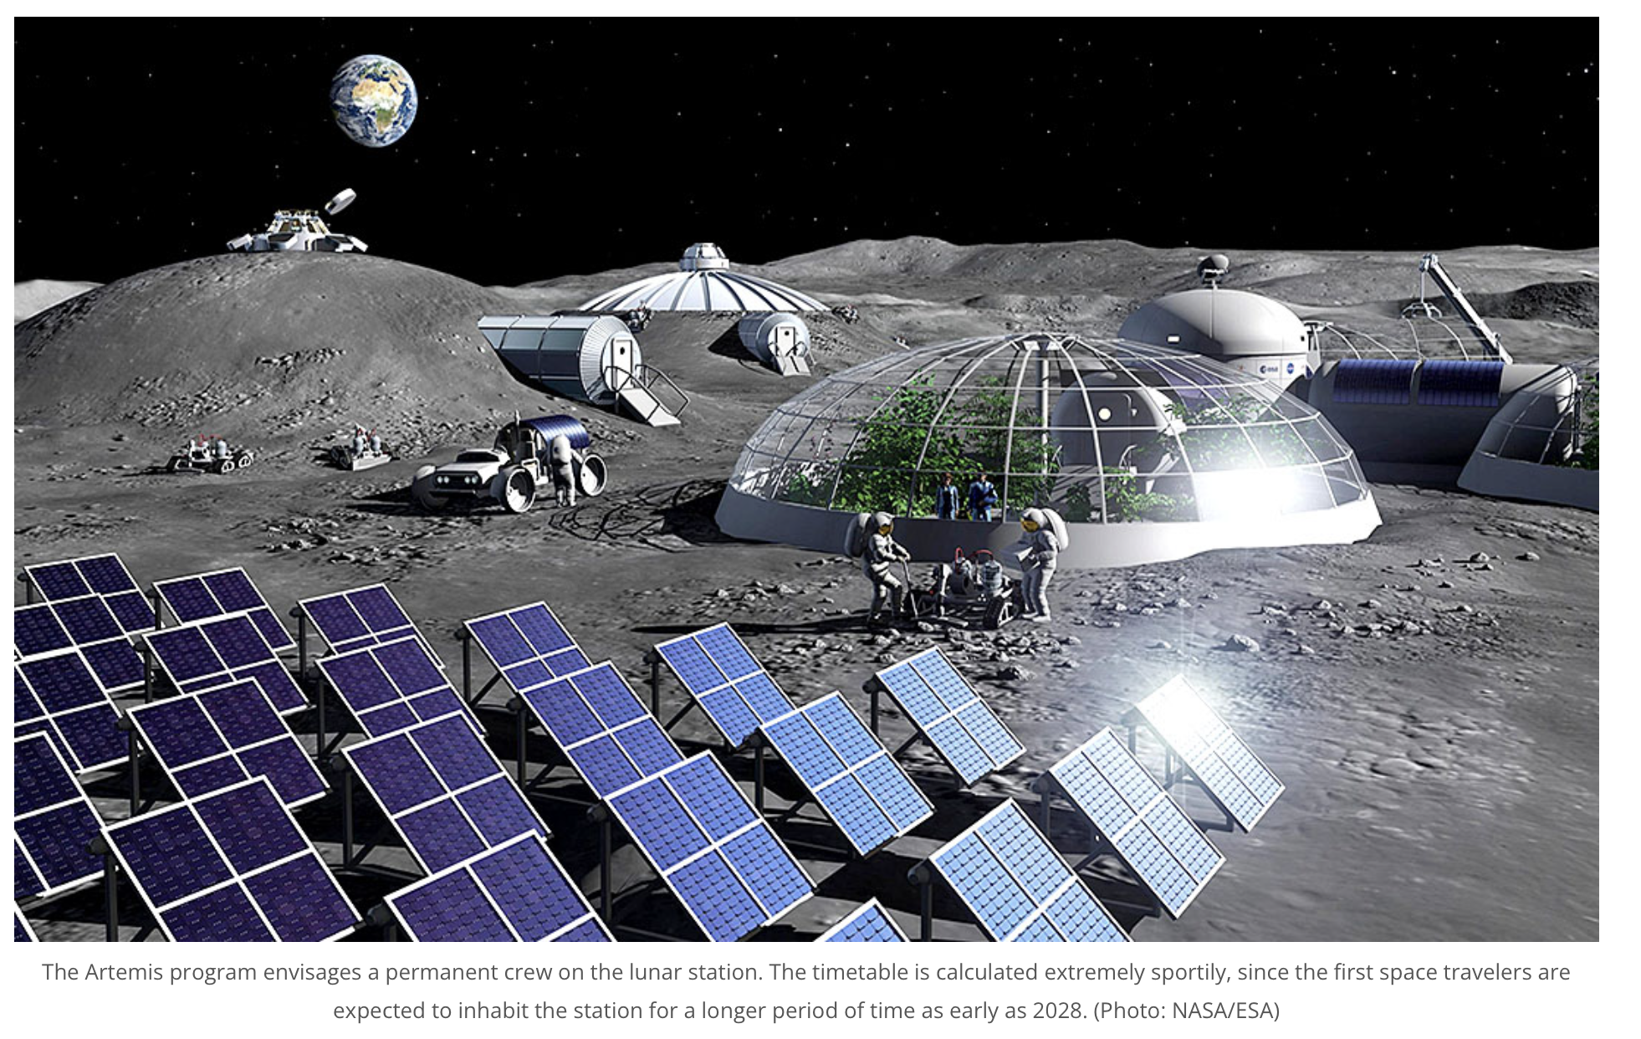
Why is thermoluminescence (TL) important?
Thermoluminescence can be used to determine the thermal history of a sample (Sehlke et al. 2024a, Sears et al. 2024, Durrani et al. 1976)
Temperature estimate
Duration of that temperature
Temperature estimates for the lunar surface are important (Sehlke et al. 2024b)
Presence of lunar resources needed for future lunar exploration depends on temperature and duration (i.e., thermal history)
Water can be used for rocket propellant and potable water in a lunar base.
Image from: https://polarjournal.ch/en/2022/07/14/nasa-plans-camp-on-lunar-south-pole/

Slide 3
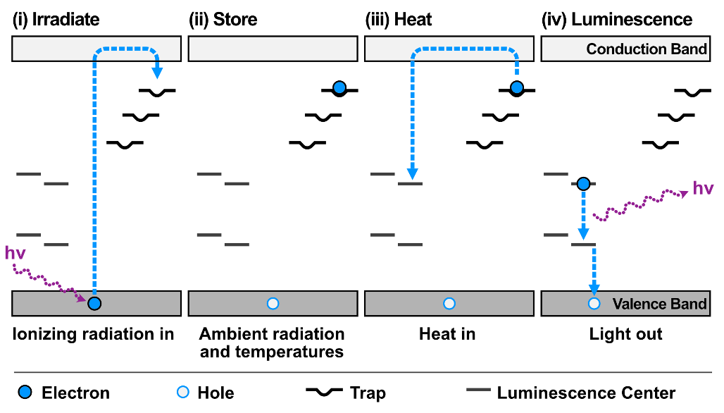
What is thermoluminescence?
Ionizing radiation excites and traps electrons into higher energy levels (E).
Heat provides necessary activation energy (E_{a}) for electrons to fall back to their ground state
Electron passes through luminescence center
Excess energy is emitted as light (hv), which is measurable (= glow curve)
Type of trap present and its stability is governed by the electron trap (E, in eV) and the Arrhenius factor (s, in s⁻¹)

Slide 4
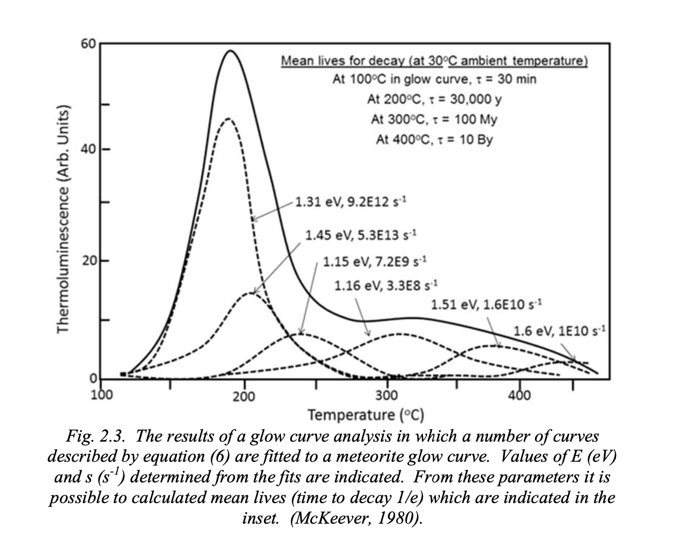
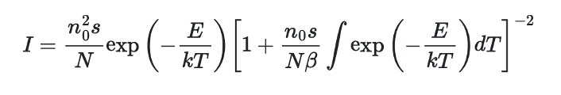
What is thermoluminescence? (cont.)
TL can be measured on lunar samples
Sample (heating) temperature against the emitted light = glow curve
Glow curve (solid line) has many underlying peaks representing individual electron traps
Need to determine these trap parameters (for example E and s)
The light emission from each of the glow curve’s individual peaks can be described with the below equation, where
E - Electron trap (eV)
s - Arrhenius factor (s⁻¹)
n₀ - number of filled traps
N - total number of available traps
β - sample heating rate

Slide 5
How do we determine TL kinetic parameters?
Experimental
Theoretical (Curve) Fitting
time-intensive
many samples needed
overlapping peaks require different experimental approaches/methods
unique solution but large data scatter
fast
minimal sample needed
untested for complex sample mineralogy in lunar samples
likely non-unique solution
With modern processing power, curve fitting may be an alternative to experimental approaches (Sehlke et al. 2023)

Slide 6
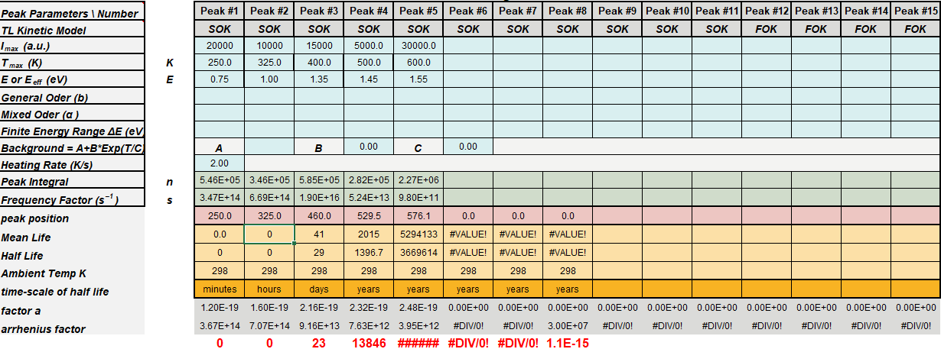
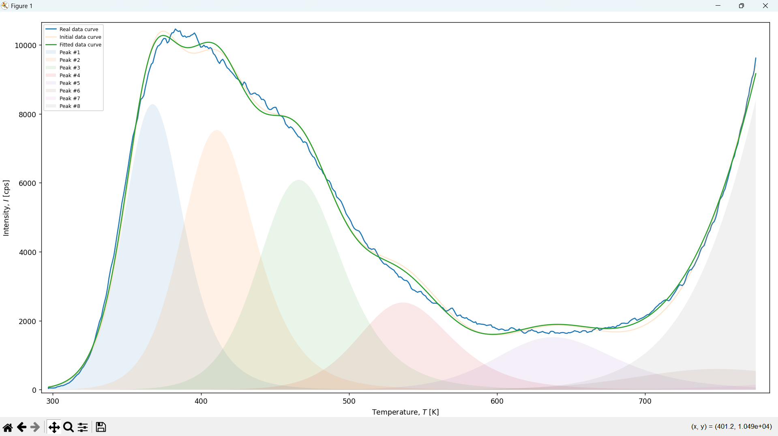
How did I create a program to theoretically determine TL parameters?
Programmed in Python to make my program open to anyone
Used clever algorithms to make computation fast.
Instead of implementing the algorithms from scratch, I used SciPy’s implementations, as well as a C++ implementation from Github.
As a result, it outperforms the Excel spreadsheet previously used to determine TL parameters (Kazakis 2019)
Python enables additional features
Different solvers
More TL parameters
Greater customizability
Kazaki’s spreadsheet
Fitted TL data

Slide 7






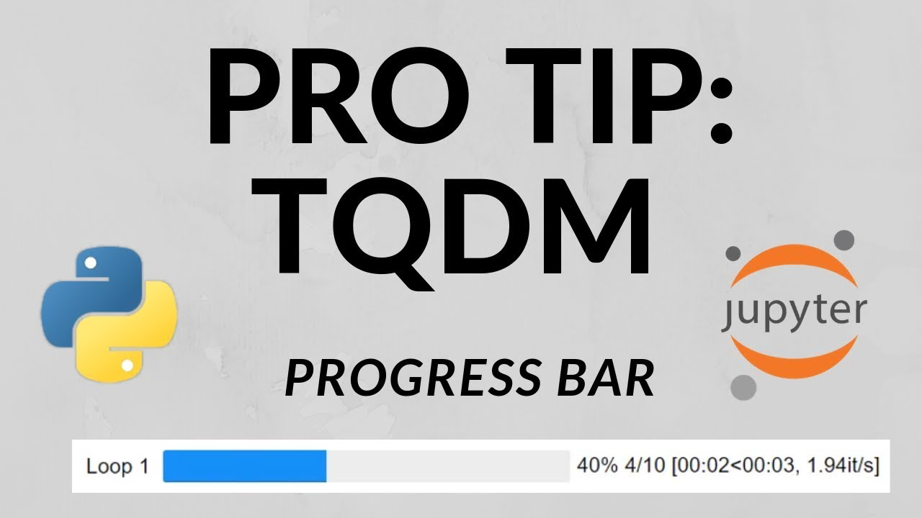

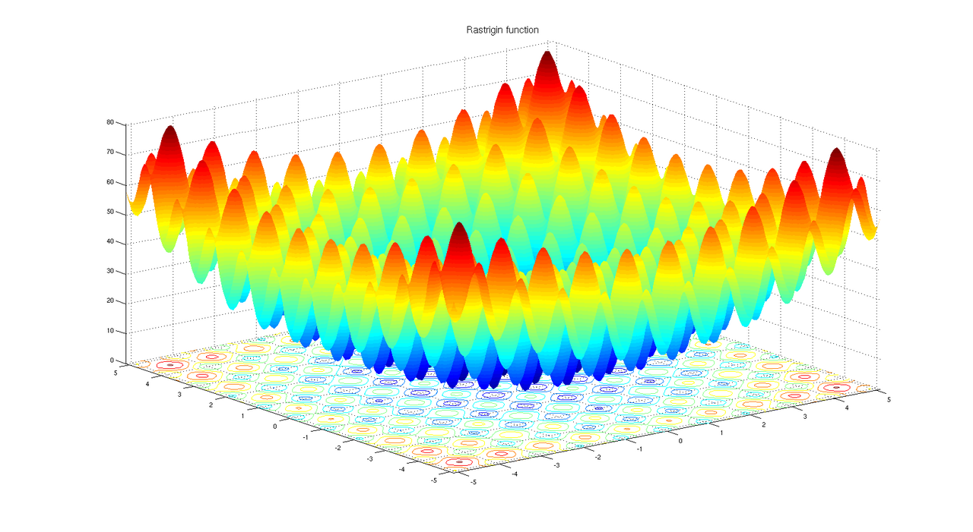
What tools did I use?
Python
SciPy - Solvers
Argparse - Command line arguments
CFFI - C++ integration
Matplotlib - Plotting graphs
TQDM - Progress bars
NumPy - Processing arrays
rich - Displaying documentation
Python Standard Library
C++
differential_evolution.h
C++ Standard Library
C++ Differential Evolution

Slide 8
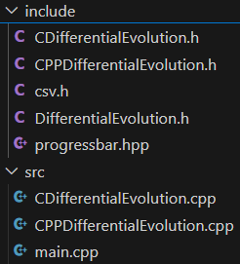
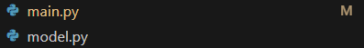
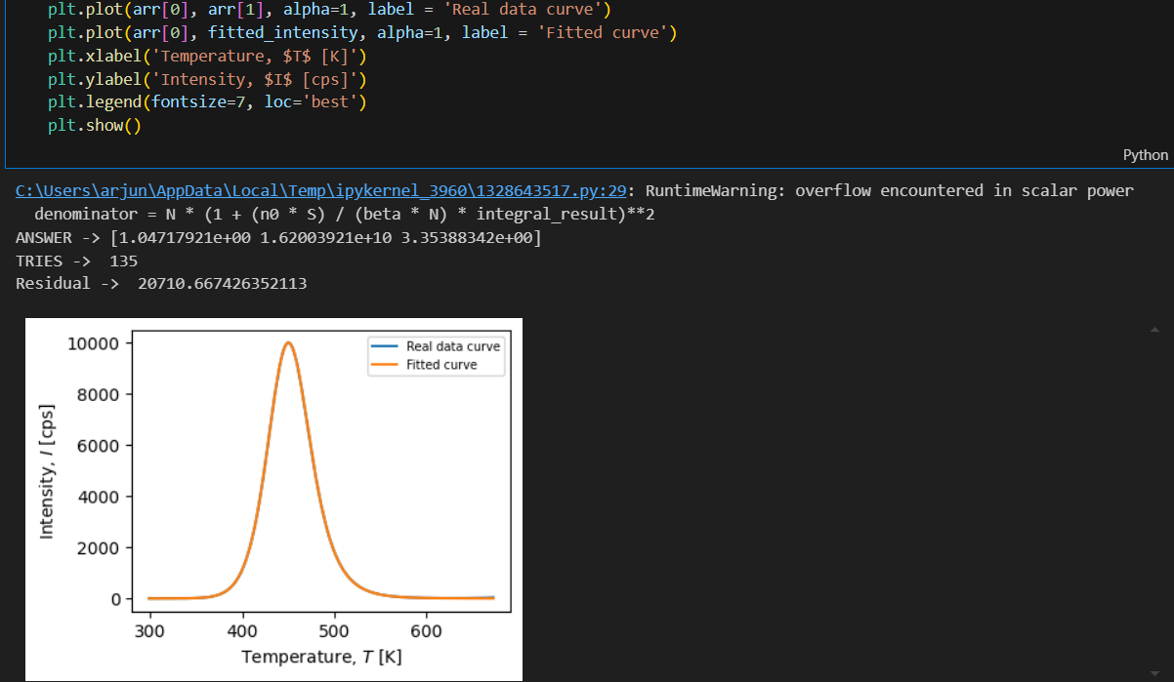
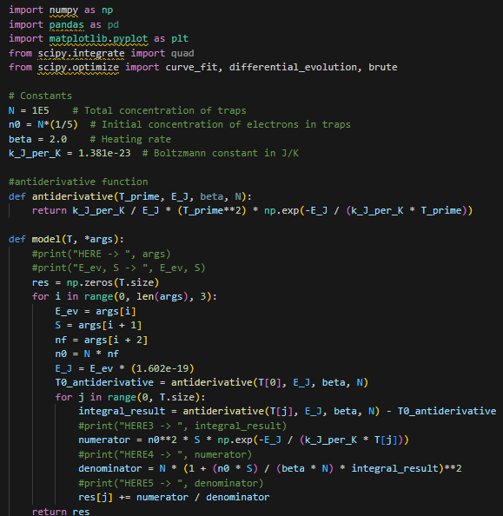


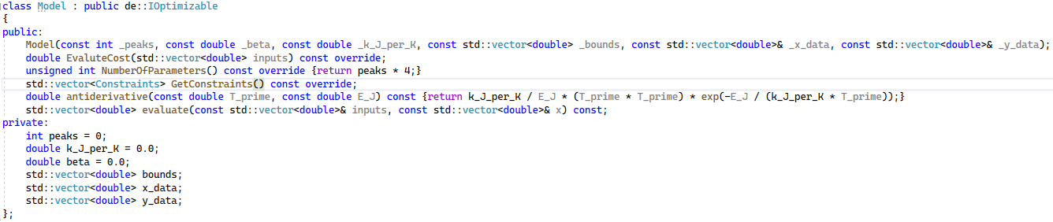
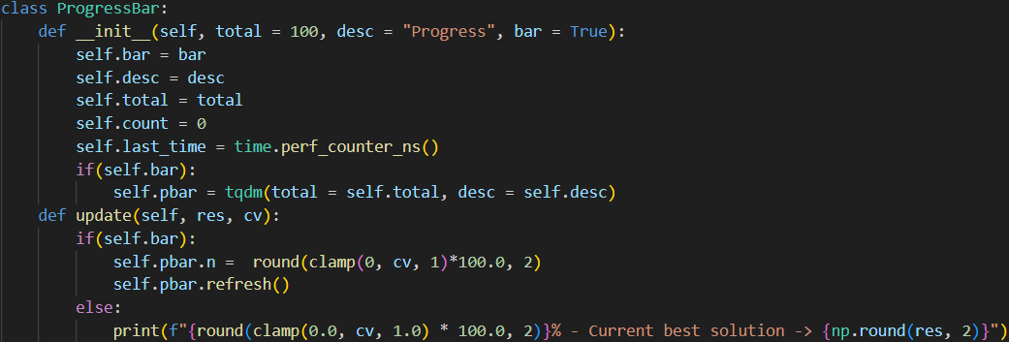
How did the code evolve?
Jupyter Notebook (61 lines of code, 1 file)
Python program (118 lines of code, 1 file)
CLI Python/C++ program (1079 lines of code, 14 files)

Slide 9
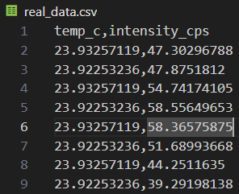
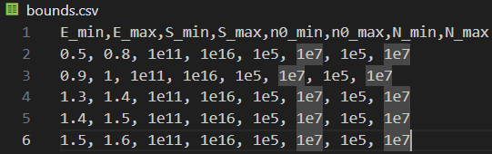
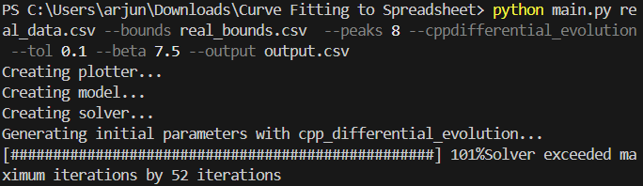
Program screenshots/output
Store glow curve in .csv file
Store parameters bounds in .csv file
Figure Of Merit: 3.8%
Run the program with the glow curve, bounds, and peaks given as command line arguments (as well as optional arguments)
Analyze the output graph and/or save it for further analysis

Slide 10
Program screenshots/output (cont.)
Figure Of Merit: 3.8%

Slide 11
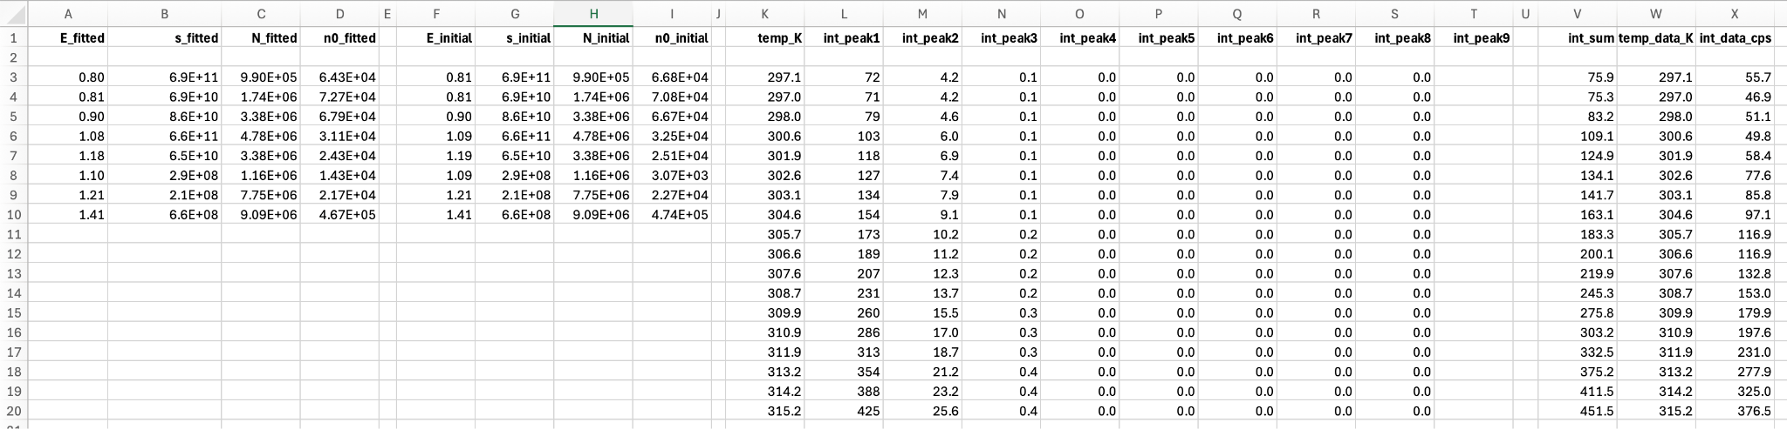
Program screenshots/output (cont.)
Fitted TL parameters
Initial starting parameters

Slide 12
Summary
What I did
Made a Python CLI program to process TL glow curves
Specifically tailored for lunar sample research.
Designed for ease of use.
Publicly available at GitHub: https://github.com/apremprojects/TL_curve_fitting
Wrote documentation explaining how to use it.
What I learned
Learned about TL and its uses in lunar science.
Learned a lot about SciPy and NumPy - libraries focused on scientific computing and algorithms.
They make processing large amounts of data fast and convenient.
Learned how to integrate C++ and Python to reduce runtime.

Slide 13
Cited References
Acknowledgements
Durrani, S. A., Khazal, K. A. R., Ali, A., Durrani, S. A., Khazal, K. A. R., & Ali, A. (1976). Temperature and duration of some Apollo 17 boulder shadows. LPSC, 1, 1157–1177.
Kazakis, N. A. (2019). TLDECOXCEL: A Dynamic Excel Spreadsheet for the Computerized Curve Deconvolution of TL Glow Curves Into Discrete-Energy and/or Continuous-Energy-Distribution Peaks. Radiation Protection Dosimetry, 187(2), 154–163. https://doi.org/10.1093/rpd/ncz150
Sehlke, A., Sears, D. W. G., & the ANGSA Science Team. (2023). Lunar Regolith Thermoluminescence Glow Curve Fitting To Extract Its Most Important Kinetic Parameters. In 54th Lunar and Planetary Science Conference, LPI Contrib. Np. 2806.
Sehlke, A., Sears, D. W. G., & the ANGSA Science Team. (2024a). The Apollo 17 Regolith: Induced Thermoluminescence Evidence for Formation by a Single Event ∼100 Million Years Ago and Possibly the Presence of Tycho Material. Journal of Geophysical Research: Planets, 129(4), e2023JE008083. https://doi.org/10.1029/2023JE008083
Sehlke A., Sears DWG, & the ANGSA Science Team. (2024b). Cold Trap Prospecting on the Moon: Theory and Insights from Low Temperature Thermoluminescence of Lunar Regolith. In preparation.
Sears, D. W. G., Sehlke, A., Schmitt, H. H., & the ANGSA Science Team. (2024, JGR Planets in review). Thermoluminescence and Apollo 17 ANGSA lunar samples: NASA’s fifty-year experiment and prospecting for cold traps. Authorea Preprints. https://doi.org/10.22541/AU.170967885.52170034/V1
I’d like to thank the N3 program, Ariana, and Alex for the opportunity to participate and learn about STEM by completing a project about thermoluminescence. This program is something I am very grateful for, and I can only hope it continues to provide others the opportunities I had.

Slide 14
Thank you for your time!
I am happy to answer any questions you may have.

Slide 15
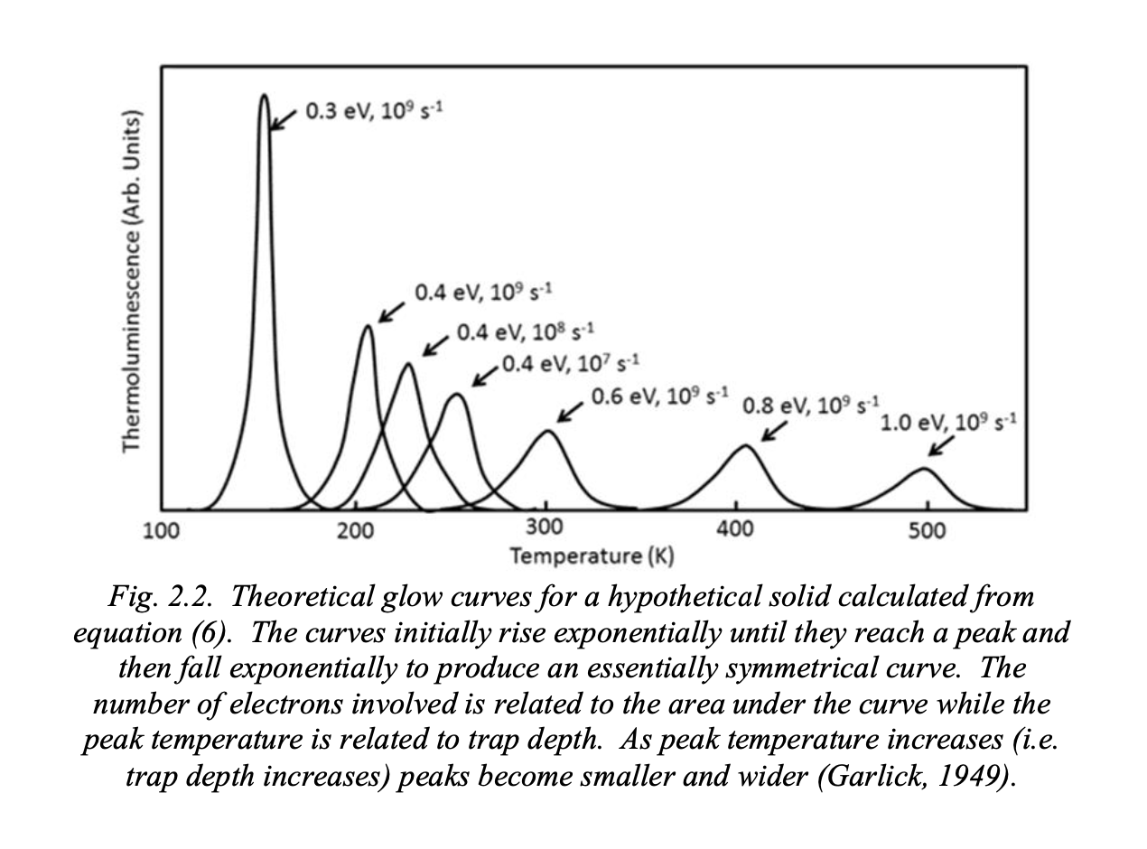
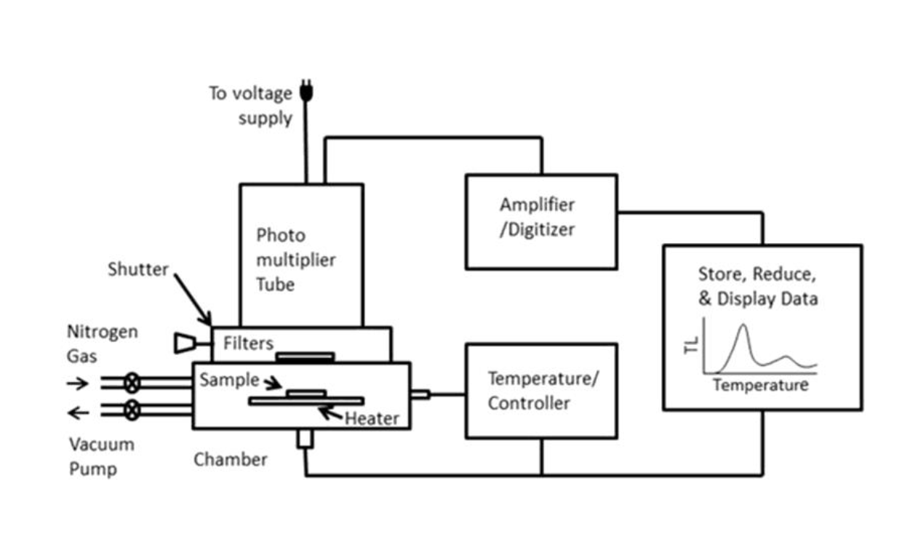

Slide 16
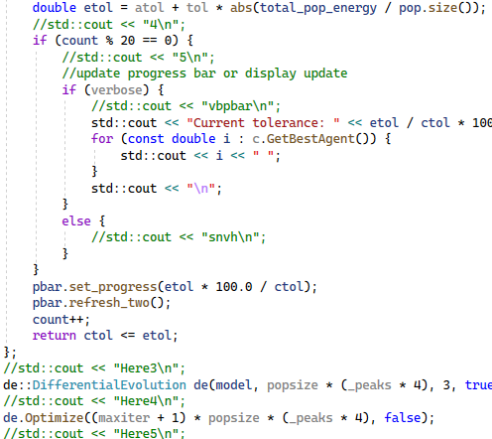
Troubleshooting
I was dealing with an issue where the program would silently crash when using the C++ Differential Evolution Solver (without creating an error).
To rectify this, I embedded a lot of “debug” prints so I could find the exact line the program stopped working so I could fix it.
I was having issues converting the documentation from Google Docs to Markdown so it could be displayed on Github.
I fixed this by using an extension to convert the documentation, instead of doing it by hand.

Slide 17
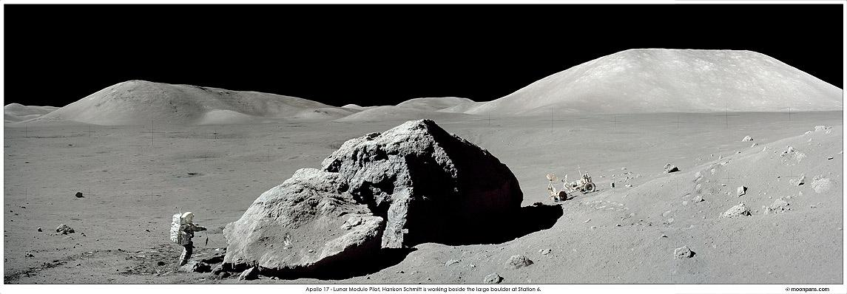

Slide 18
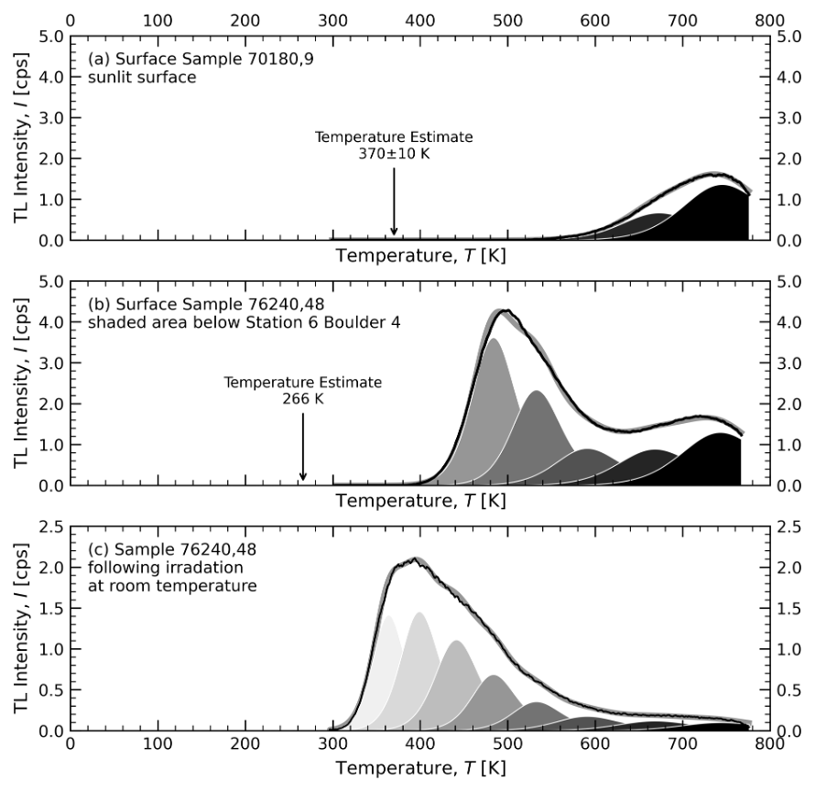
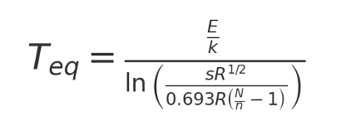
Peaks can be used to determine the temperature at which they are in thermal equilibrium, and the time it took to reach equilibrium
Thermal history of boulder shadow in equatorial regions, roughly 260 K for over 50,000 years

